Slide 1
Computer Organization & Design 实验与课程设计
Computer Organization & Design
实验十二
多周期CPU指令扩展设计
施青松
Asso. Prof. Shi Qingsong
College of Computer Science and Technology, Zhejiang University
zjsqs@zju.edu.cn

Slide 2
Course Outline
Environment
Task
Principles
Implementation
Notes:
Rudimentary logic functions=基本的逻辑函数

Slide 3
Course Outline
Environment
Task
Principles
Implementation
Notes:
Rudimentary logic functions=基本的逻辑函数

Slide 4
Task
1. Extend the instruction set for multicycle CPU
To include at least the following instructions
R-Type：add, sub, and, or, xor, nor, slt, srl*, jr, jalr, eret；
I-Type： addi, andi, ori, xori, lui, lw, sw, beq, bne, slti
J-Type： J, Jal*；
Encourage to do customized design
Must compatible with the basic instruction set
2. Design instruction set testing schema and program
Testing schema and program
Demo program: simple but meaningful
Simplified version of project

Slide 5
Course Outline
Environment
Task
Principles
Implementation
Notes:
Rudimentary logic functions=基本的逻辑函数

Slide 6
CPU organization
Digital circuit
General circuits that controls logical event with logical gates --Hardware
Computer organization
Special circuits that processes logical action with instructions -Software
Data input
Control unit
Control signals
Datapath
Data output
Status input
Status signals
Control output

Slide 7
Multicycle datapath：compatible with 9-23⁺ instructions
Find datapath for each instruction：5+1个MUX
Which part are added or modified？
修改

Slide 8
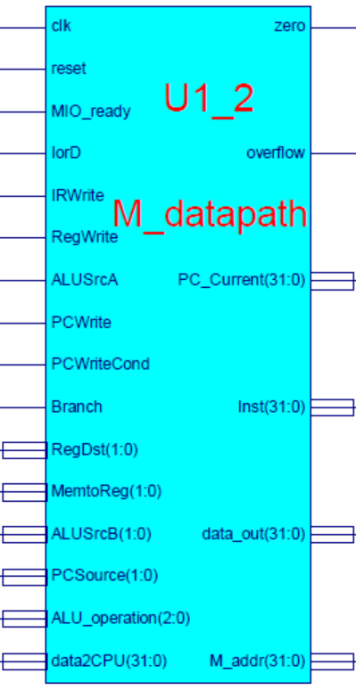
Datapath of lab10：M_datapath
Key signals
Branch
Branch：=1→beq；=0 → bne
Condition indication：PCWriteCond
Path control signal
MemtoReg(1:0)：4-to-1, lab10 use only 2 channels
RegDst(1:0)：4-to-1, lab10 only use 2 channels
PCSource(1:0)：4-to-1, lab10 only use 3 channels
Other signals
Inst_R：指令寄存器输出
PC_Current：当前PC(PC+4)
M_addr：存储器地址

Slide 9
Datapath interface- M_datapath.v
module M_datapath(input clk,
input reset,
input MIO_ready, //外部输入=1
input IorD,
input IRWrite,
input[1:0] RegDst, //预留到2位
input RegWrite,
input[1:0]MemtoReg, //预留到2位
input ALUSrcA,
input[1:0]ALUSrcB,
input[1:0]PCSource, //4选1控制
input PCWrite,
input PCWriteCond,
input Branch,
input[2:0]ALU_operation,
output[31:0]PC_Current,
input[31:0]data2CPU,
output[31:0]Inst,
output[31:0]data_out,
output[31:0]M_addr,
output zero,
output overflow
);
endmodule

Slide 10
Control signals：
兼容实验十基本多周期通路与操作控制
信号 | 源数目 | 功能定义 | 赋值0时动作 | 赋值1时动作
ALUScrA | ？ | ALU端口A输入选择
ALUSrc_B(1:0) | ？ | ALU端口B输入选择
RegDst(1:0) | ？ | 寄存器写地址选择
MemtoReg(1:0) | ？ | 寄存器写入数据选择
IorD | ？ | 指令或数据地址选择
PCSource | ？ | Next-PC指针选择
PCWriteCond | ？ | 条件指令指示
Branch | ？ | Beq、Bne指示
RegWrite | - | 寄存器写控制
MemWrite | - | 存储器写控制
MemRead | - | 存储器读控制
…… | ？ | 个性化设计新增(需修改电路符号sym)
ALU_Control | 000- 111 | 3位ALU操作控制 | 参考表 Exp04 | Exp04
请填写信号赋值时
对应操作

Slide 11
Controller and control object

Slide 12
FSM for 18⁺instructions： asking the students to complete the corresponding state truth table
根据数据通路设计所有指令状态机

Slide 13
Fill in the following table: refer to lab 11
状态 输出信号 | 0000 | 0001 | 0010 | 0011 | 0100 | 0101 | 0110 | 0111 | 1000 | 1001 | 增加
 | IF | ID | MEN-Ex | MEN-RD | LW_WB | MEM_W | R_Exc | R_WB | Beq_Exc | J | …… | …… | ……
PCWrite
PCWriteCond
IorD
MemRead
MemWrite
IRWrite
MemtoReg1
MemtoReg0
PCSource1
PCSource0
ALUSrcA
ALUSrcB1
ALUSrcB0
RegWrite
RegDst1
RegDst0
Branch
ALU_operation
MEM_IO
……
请分析完成输出信号真值表

Slide 14
State table for 9 instructions as reference
建议直接输出存储器写控制信号：men_w
建议直接输出ALU控制信号：ALU_operation

Slide 15
Controller implementation
Controller implementation
Instruction implementation use one level decoding
Main controller directly output ALU_operation
ALU decoder can use the module of single cycle CPU
FSM implementation
Suggest to use HDL description based on state table：
Same as project design，easy for optimization and extension
Separate output from state transition
Clear struture
HDL description
note：there is one clock difference if put output and state machine together

Slide 16
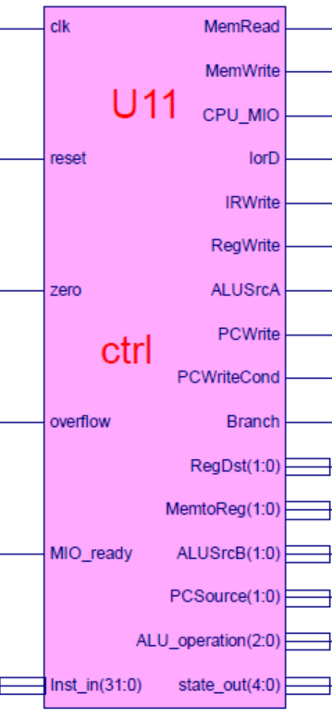
Controller module：ctrl
Key signals:
Branch
Branch：=1→beq；=0 → bne
Condition indication：PCWriteCond
Path control signal
MemtoReg(1:0)：4-to-1, lab10 use only 2 channels
RegDst(1:0)：4-to-1, lab10 only use 2 channels
PCSource(1:0)：4-to-1, lab10 only use 3 channels
Other signals
MIO_ready：外设就绪
=0 CPU等待；=1 CPU正常运行
本实验恒等于1
CPU_MIO：CPU访问存储器指示
Inst_R：指令寄存器输出
PC_Current：当前PC(PC+4)
M_addr：存储器地址
State_out：状态编码，用于测试

Slide 17
Controller interface- ctrl.v
module ctrl(input clk,
input reset,
input [31:0] Inst_in,
input zero,
input overflow,
input MIO_ready, //外部输入=1
output reg MemRead,
output reg MemWrite,
output reg[2:0]ALU_operation, //ALU_Control
output [4:0]state_out,
output reg CPU_MIO,
output reg IorD,
output reg IRWrite,
output reg [1:0]RegDst, //实验十预留到2位
output reg RegWrite,
output reg [1:0]MemtoReg, //实验十预留到2位
output reg ALUSrcA,
output reg [1:0]ALUSrcB,
output reg [1:0]PCSource,
output reg PCWrite,
output reg PCWriteCond,
output reg Branch
);
endmodule

Slide 18
U3-memory initialization：mem.coe code and data are together
memory_initialization_radix=16;
memory_initialization_vector=
3c03f000, 2014003f, 3c088000, 00632020, 20020001, 00000827, 00205020, 20070003, 00e73827, 20067fff,
00008820, 200502ab, ac650000, 20120002, ac600004, 8c650000, 00a52820, 00a52820, ac650000, ac660004,
3c0dffff, 8c650000, 00a52820, 00a52820, ac650000, 8c650000, 00a85824, 21ad0001, 11680015, 8c650000,
20120018, 00b25824, 11600005, 1172000a, 20120008, 1172000b, ac890000, 08000015, 11410001, 0800002a,
00005027, 014a5020, ac8a0000, 08000015, 8e2902a0, ac890000, 08000015, 8e290260, ac890000, 08000015,
3c0dffff, 014a5020, 01425025, 22310004, 02348824, 21290001, 11210001, 0800003b, 21290005, 8c650000,
00a55820, 016b5820, ac6b0000, ac660004, 8c650000, 00a85824, 1168fffd, 0800001d, 00000000, 00000000,
00000000, 00000000, 00000000, 00000000, 00000000, 00000000, 00000000, 00000000, 00000000, 00000000,
………………
………………
f0000000, 000002AB, 80000000, 0000003F, 00000001, FFFF0000, 0000FFFF, 80000000, 00000000, 11111111, 22222222, 33333333, 44444444, 55555555, 66666666, 77777777, 88888888, 99999999, aaaaaaaa, bbbbbbbb, cccccccc, dddddddd, eeeeeeee, ffffffff, 557EF7E0, D7BDFBD9, D7DBFDB9, DFCFFCFB, DFCFBFFF, F7F3DFFF, FFFFDF3D, FFFF9DB9, FFFFBCFB, DFCFFCFB, DFCFBFFF, D7DB9FFF, D7DBFDB9, D7BDFBD9, FFFF07E0, 007E0FFF,
03bdf020, 03def820, 08002300;
Code section：address starts from 00000000
Data section：starting address needs to be appointed

Slide 19
Course Outline
Environment
Task
Principles
Implementation
Notes:
Rudimentary logic functions=基本的逻辑函数

Slide 20
project：OExp12-MSOC
Extend the instruction set for multicycle CPU
To include at least the following instructions
R-Type：add, sub, and, or, xor, nor, slt, srl*, jr, jalr, eret；
I-Type： addi, andi, ori, xori, lui, lw, sw, beq, bne, slti
J-Type： J, Jal*；
Integration and substitution with verified new CPU
Replace ctrl module of Exp11
Replace M_Datapath of Exp11
Top module is the same as Exp11
name：OExp11_MCPU/MSOC.sch
Test extended CPU
Design test program (MIPS assembling) to test

Slide 21
Multicycle CPU extension
Datapath and controller design

Slide 22
Design gist
Design extended datapath for multicycle CPU
Modify datapath based on Exp11
Implement datapath and simulation
Design extended controller for multicycle CPU
Design state diagram based on new datapath and instruction execution
Get state table and output truthtable based on state diagram
Implement controller based on state table
HDL structural description
Controller simulation
Integration and substitution
Replace ctrl.v of Exp11
Still use top module of Exp11：name：OExp11_MCPU.v
Controller test
Design test program (MIPS assembling) ：
OP decoding test：R-format、memory access instr、branch instr，jump instr

Slide 23
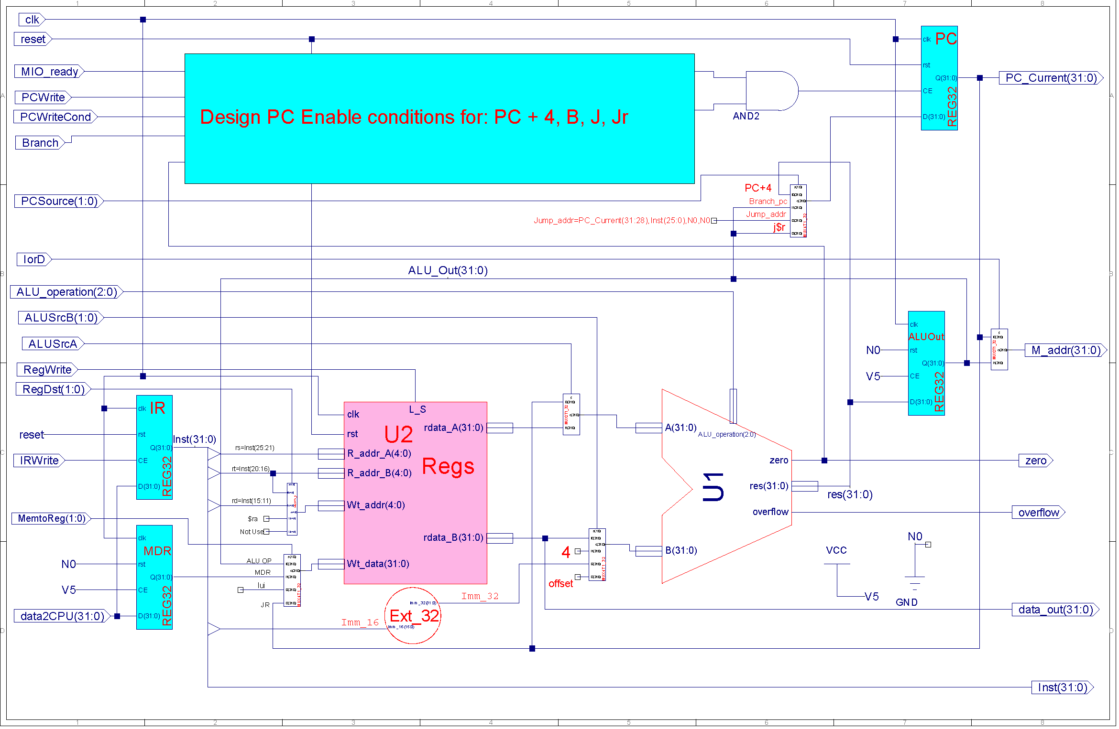
Extended M_Datapath design reference

Slide 24
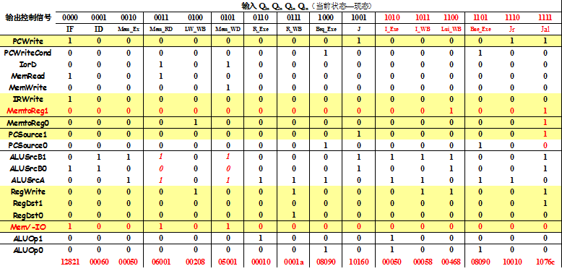
State table of 23 instructions for reference
首先完成状态真值表，然后设计状态机
由于信号定义和指令状态机划分不同结果也会不同

Slide 25
Controller HDL description structure
Main controller state machine description
parameter IF = 5'b00000, ID=5'b00001, EX_R= 5'b00010, EX_Mem=5'b00011, EX_I= 5'b00100,
Lui_WB=5'b00101, EX_beq=5'b00110, EX_bne= 5'b00111, EX_jr= 5'b01000, EX_JAL=5'b01001,
Exe_J = 5'b01010, MEM_RD=5'b01011, MEM_WD= 5'b01100, WB_R= 5'b01101, WB_I=5'b01110, WB_LW=5'b01111, Error=11111;
parameter AND=3'b000, OR=3'b001, ADD=3'b010, SUB=3'b110,
NOR=3'b100, SLT=3'b111, XOR=3'b011, SRL=3'b101;
`define CPU_ctrl_signals {PCWrite, PCWriteCond, IorD, MemRead, MemWrite, IRWrite, MemtoReg, PCSource, ALUSrcB, ALUSrcA, RegWrite, RegDst, CPU_MIO, ……}
always @ (posedge clk or posedge reset)begin
……
end
always @* begin
…… 输出变量(信号)描述
…… ALU操作控制描述
end
ALU操作译码描述
状态机
数据通路控制(含ALU)

Slide 26
State transition description
always @ (posedge clk or posedge reset)
if (reset==1) state <= IF;
else
case (state)
IF: if(MIO_ready) state <= ID;
else state <= IF;
ID: case (Inst_in[31:26])
6'b000000: state <= state <= EX_R; //R-type OP
6'b100011: state <= EX_Mem; //Lw
………………
6'b000100: state <= EX_beq; //Beq
6‘b000101: state <= EX_bne; //Bne
………………
default: state <= Error;
endcase
Mem_Ex:begin
…………
Error: state <= Error;
default: state <= Error;
endcase

Slide 27
Output description：value should be redefined after instruction extension
always @ * begin
case(Q) //state
IF: begin ` CPU_ctrl_signals = value0; ALU_operation = ADD; end ID: begin ` CPU_ctrl_signals = value1; ALU_operation = ADD; end
EX_Mem: begin ` CPU_ctrl_signals = value2; ALU_operation = ADD; end
EX_R: begin ` CPU_ctrl_signals = value6;
case (Inst_in[5:0])
6‘b100000: ALU_operation = ???? ;
6‘b100010: ALU_operation = ???? ;
…………
default: ALU_operation <= ADD;
endcase
end
MEM_RD: begin ` CPU_ctrl_signals = value3; ALU_operation = ADD; end
WB_LW : begin ` CPU_ctrl_signals = value4; ALU_operation = ADD; end
……………………
default: begin ` CPU_ctrl_signals = value0; ALU_operation = ADD; end
endcase
R-Type

Slide 28
ALU operation decoding for state EX_R
ALU decoder for R-format instruction
EX_R: begin ` CPU_ctrl_signals = value6;
case (Inst_in[31:26]) //R-type OP
6'b100000: ALU_operation <= ？;
6'b100010: ALU_operation <= ?;
6'b100100: ALU_operation <= ?;
6'b100101: ALU_operation <= ?;
6'b100111: ALU_operation <= ?;
6'b101010: ALU_operation <= ?;
6'b000010: ALU_operation <= ?; //SP3 shfit 1bit right
6'b000000: ALU_operation <= ?;
6'b001000: ALU_operation <=ADD; //Jr
default: ALU_operation <= ADD;
endcase
end
There is one clock delay if output and states are put together

Slide 29
Multicycle CPU extension
Integration and substitution

Slide 30
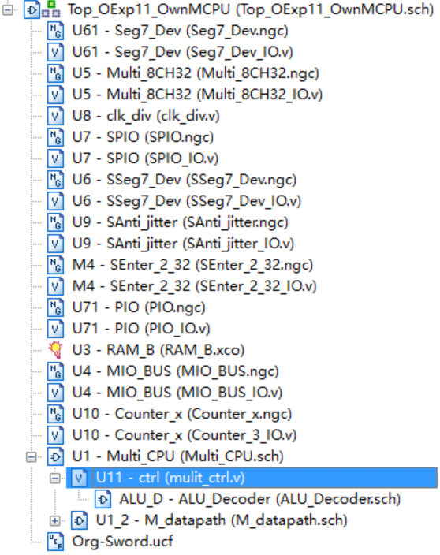
Controller substitution
Integration and substitution
Substitute the following of Exp11 after correct simulation
datapath、controller
Remove the connections from project Exp11
Remove datapath connection
Remove controller connection
Replace datapath file
M_Datapath.v
Replace controller file
ctrl.v文件
In Project menu, run： Cleanup Project Files …
Suggest to rebuild a project use Exp11 resources
Except M_Datapath.v and ctrl.v
Exp11 Modules to be replaced Exp11

Slide 31
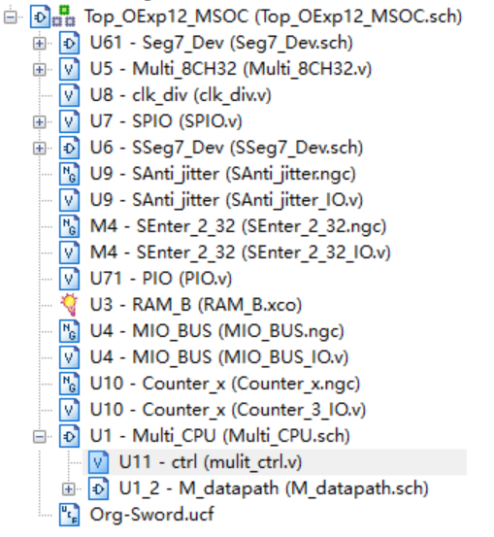
Module structure after substitution
Module call relations after Exp12 datapath substitution
Datapath and controller after substitution

Slide 32
Physical verification
使用DEMO程序目测控制器功能
DEMO接口功能： (同实验11，代码不同)
SW[7:5]=000， SW[2]=0(全速运行)
SW[4:3]=00， SW[0]=0，点阵显示程序：跑马灯
SW[4:3]=00， SW[0]=0，点阵显示程序：矩形变幻
SW[4:3]=01， SW[0]=1，内存数据显示程序：0～F
SW[4:3]=10， SW[0]=1，当前寄存器R9+1显示
用汇编语言设计测试程序
测试ALU指令(R-格式译码、 Function译码)
测试LW/SW指令(I-格式译码)
测试分支指令(I-格式译码)
测试转移指令(J-格式译码)

Slide 33
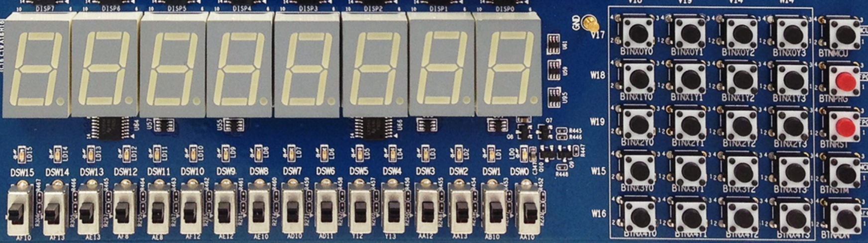
DEMO interface function
X₀Y₀
X₀Y₁
X₀Y₂
X₀Y₃
MCU3
0
1
2
3
X₁Y₀
X₁Y₁
X₁Y₂
X₁Y₃
PRGO
SEG3
SEG2
SEG1
SEG0
SEG3
SEG2
SEG1
SEG0
4
5
6
7
X₂Y₀
X₂Y₁
X₂Y₂
X₂Y₃
RSTN
LED15 LED14 LED13 LED12 LED11 LED10 LED9 LED8 LED7 LED6 LED5 LED4 LED3 LED2 LED1 LED0
8
9
A
B
X₃Y₀
X₃Y₁
X₃Y₂
X₃Y₃
MCU1~2
C
D
E
F
W15 SW14 SW13 SW12 SW11 SW10 SW9 SW8 SW7 SW6 SW5 SW4 SW3 SW2 SW1 SW0
X₄Y₀
X₄Y₁
X₄Y₂
X₄Y₃
Ardunio
SW[7:5]=显示通道选择
SW[7:5]=000：CPU程序运行输出
SW[7:5]=001：测试PC字地址
SW[7:5]=010：测试指令字
SW[7:5]=011：测试计数器
SW[7:5]=100：测试RAM地址
SW[7:5]=101：测试CPU数据输出
SW[7:5]=110：测试CPU数据输入
SW[0]=文本图形选择
SW[1]=高低16位选择
没有使用
SW[2]=CPU单步时钟选择
DEMO功能，测试程序可以替换成自己的功能
SW[4:3]=00，点阵显示程序：跑马灯
SW[4:3]=00，点阵显示程序：矩形变幻
SW[4:3]=01，内存数据显示程序：0～F
SW[4:3]=10，当前寄存器+1显示

Slide 34
Test program reference
设计CPU功能测试方案和测试例程
物理调试正确后，设计测试方案与测试程序
演示程序：简单有意义的DEMO
修改DEMO兼有测试、自检并有一定趣味
Project的简化版

Slide 35
END

